Slide 1

Internet of Things

Slide 2
Arsitektur IoT
Basic Technologies
IoT Simulation
Internet of Things

Slide 3
Arsitektur IoT
Network Layer
Content Layer
User interface devices (e.g. computer screens, PoS stations, tablets, smart glasses, smart surfaces)
Hardware: CPS, machines, sensors
Service Layer
Device Layer
Applications, software to analyze data and transform it into actionable information
Communications protocols, Wi-Fi, Bluetooth, LoRa, cellular

Slide 4
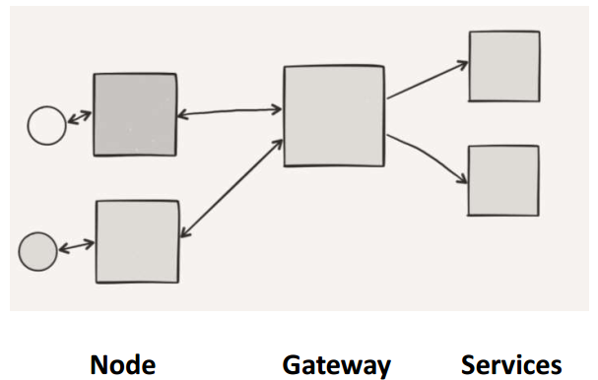
Arsitektur IOT

Slide 5
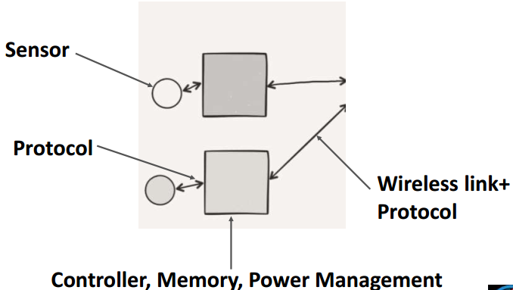
Arsitektur IOT : NODE

Slide 6
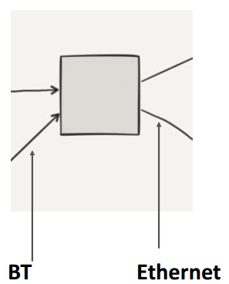
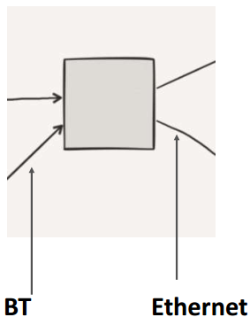
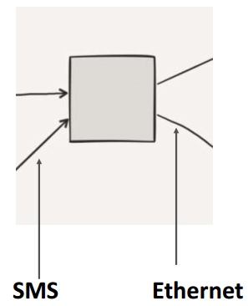
Arsitektur IOT : Gateway

Slide 7
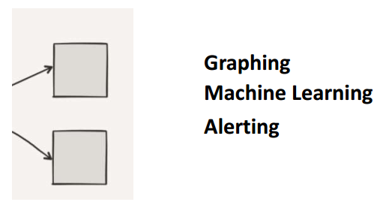
Arsitektur IOT : Services

Slide 8
BASIC TECHNOLOGIES
Things
Data Analytics
Gateways/Cloud Gateways
Big Data Warehouse
Streaming Data Processor
Machine Learning
Data Lake
User Application

Slide 9
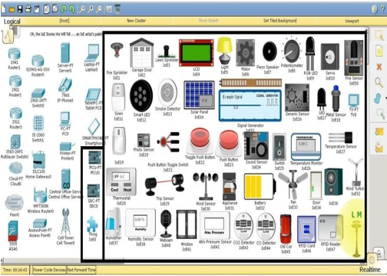
PACKET TRACER IOT SIMULATION

Slide 10
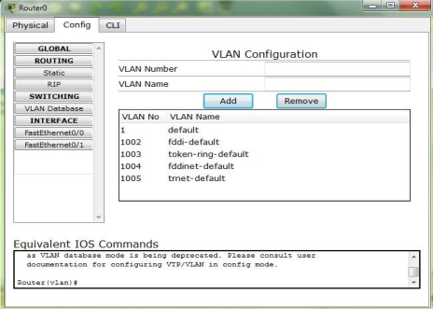
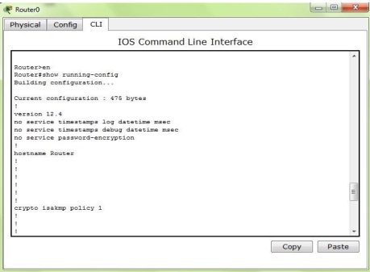
Packet Tracer DEVICE CONFIGURATION METHOD

Slide 11
Packet Tracer Protocols
Layer | Protocols
Application | FTP,SMTP, POP3, HTTP, TFTP, Telnet, SSH, DNS, DHCP, NTP, SNMP,AAA, ISR VOIP, SCCP config and calls ISR command support, Call Manager Express
Transport | TCP and UDP, TCP Nagle Algorithm & IP Fragmentation, RTP
Network | BGP, IPv4, ICMP, ARP, IPv6, ICMPv6, IPSec, RIPv1/ v2/ng, Multi Area OSPF, EIGRP, Static Routing, Route Redistribution, Multilayer Switching, L3 QoS, NAT, CBAL, Zone-based policy firewall and Intrusion Protection System on the ISR, GRE VPN, IPSec VPN
Network Access/ Interface | Interface Ethernet (802.3), 802.11, HDLC, Frame Relay, PPP, PPPoE, STP, RSTP, VTP, DTP, CDP, 802.1q, PAgP, L2 QoS, SLARP, Simple WEP, WPA, EAP

Slide 12
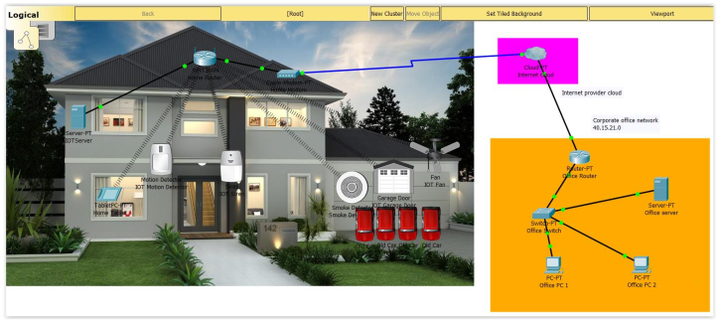
SMART HOME EXAMPLE

Slide 13
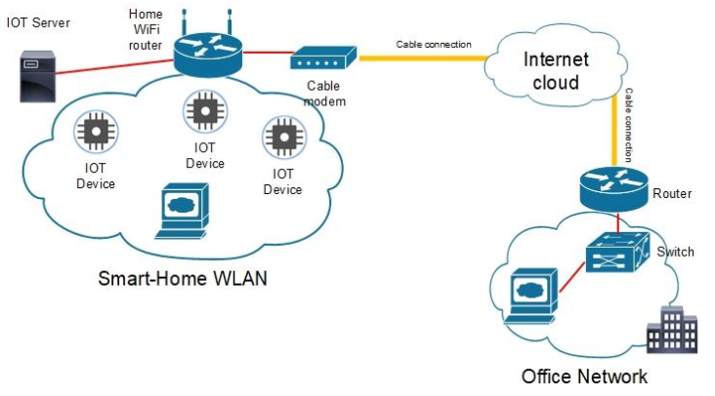
SMART HOME NETWORK TOPOLOGY

Slide 14
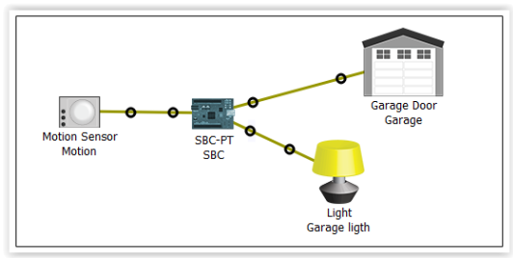
SMART HOME MICROCONTROLLER

Slide 15
EXercise
Jelaskan Cara Kerja Arsitektur IoT ! Disertai dengan bagan/skema/gambar
Buatlah simluasi IoT Smart Home sederhana menggunakan packet tracer. Contoh ada di video.
Alat yang digunakan : 2 Home device (usahakan berbeda dengan device yang ada di video), 1 Home Gateway, 1 Smartphone
Tugas 1 dan 2 dikerjakan di word. Untuk tugas no 2, Capture tiap langkah yang dikerjakan disertai penjelasan
Terdapat 2 file yang dikumpulkan :
File word hasil pengerjaan nomor 1 dan 2
File hasil simulasi di packet tracer (simulasi.pkt)
5. Semua file di jadikan 1 berbentuk rar/zip dan dikumpulkan dengan format :
IoT_namakelas_nim_nama
File di kumpulkan di SPADA paling lambat tanggal .... Jam ....

Slide 16

Referensi
https://internetofthingsagenda.techtarget.com/definition/Industrial-Internet-of-Things-IIoT
https://www.trendmicro.com/vinfo/us/security/definition/industrial-internet-of-things-iiot
https://www.i-scoop.eu/internet-of-things-iot/industrial-internet-things-iiot-saving-costs-innovation/
Yoo, Youngjin; Henfridsson, Ola; Lyytinen, Kalle (2010-12-01). "Research Commentary---The New Organizing Logic of Digital Innovation: An Agenda for Information Systems Research". Information Systems Research. 21 (4): 724–735. doi:10.1287/isre.1100.0322. ISSN 1526-5536.
https://www.iiot-center.org/
https://sis.binus.ac.id/2019/10/24/elemen-dasar-arsitektur-iot/

Slide 17


